Slide 1
1Q 2025
JPMorgan
SmartRetirement
Blend Funds
Target date funds that help put participants on the path to the retirement they’ve earned
NOT FDIC INSURED | NO BANK GUARANTEE | MAY LOSE VALUE

Slide 2
Designing target date strategies around real-life saving and spending behavior
We know people. We know markets.
1 | 2 |  | 3 |  | 4
Set objective | Glide Path development |  | Strategy selection |  | Asset allocation views
Bring as many participants as possible to the finish line with more certainty and help them enjoy their savings through retirement. | Participant Behavior Research | Long-Term Capital Market Assumptions | 600+ Investment Strategies¹ | 188 ★★★★ & ★★★★★ rated funds² | • Quantitative analysis • Qualitative insights
 | The glide path is an active decision, driving the majority of returns.
1 Source: J.P. Morgan Asset Management; as of 9/30/24.
2 Source: Morningstar; as of 3/31/25.
The manager seeks to achieve the stated objectives. There can be no guarantee the objectives will be met.
Notes:
The SmartRetirement glide path is designed to get more people over the finish line by targeting a 90% replacement ratio to support long-term spending needs, such as:
Sufficient income replacement: “I am confident what I have saved in my DC account coupled with Social Security is enough for me to live comfortably in retirement.”
Support long-term spending needs: “I have peace of mind because I know how much I can afford to spend and have control. I am confident I have enough to enjoy my retirement.”
There are three parts to the process:
Glide Path – annual review of the glide path that incorporates our Long-Term Capital Markets Assumptions and participant cash flows to ensure we manage the impact of cash flow volatility and market risk.
This is the “beta” exposure and delivers most of the participant’s experience in the funds.
In fact, the glide path drives 90% of returns.
Strategy Selection – include active managers and/or passive opportunities within the glide path.
Asset Allocation Views – implemented in periods of heightened risks/volatility or potential opportunity for higher returns over the next 12+ months.

Slide 3
Where is the finish line?
Peak salary | Income replacement rate | Social security | Employer plan | Savings needed
30k | 98% | 73% | 25% | $90,000
40k | 96% | 66% | 30% | $200,000
50k | 94% | 61% | 33% | $300,000
60k | 93% | 58% | 34% | $410,000
70k | 92% | 55% | 38% | $575,000
80k | 89% | 50% | 39% | $690,000
90k | 88% | 47% | 40% | $850,000
100k | 86% | 44% | 42% | $1,000,000
125k | 83% | 37% | 45% | $1,460,000
150k | 80% | 33% | 47% | $1,890,000
175k | 78% | 28% | 50% | $2,390,000
200k | 76% | 25% | 51% | $2,870,000
250k | 73% | 20% | 53% | $3,840,000
300k | 72% | 16% | 56% | $4,890,000
Source: J.P. Morgan Asset Management analysis, 2022. Household income replacement rates are derived from an inflation-adjusted analysis of: Consumer Expenditure Survey (BLS) data (2016-2019) for income and longitudinal Chase data (2013-2020) for spending. Chase data includes internal select data from JPMorgan Chase Bank, N.A. and its affiliates (collectively “Chase”) including select Chase check, cash, credit and debit card, and electronic payment transactions from January 1, 2013 – December 31, 2020. Additional information on J.P. Morgan Asset Management’s data privacy standards available at https://am.jpmorgan.com/us/en/asset-management/mod/insights/retirement-insights/gtr-privdisc/. Social Security benefits uses modified scaled earnings in 2021 for a single wage earner at age 65 and a spousal benefit at age 63. The income replacement needs may be lower for households in which both spouses are working and the second spouse’s individual benefits are greater than their spousal benefit. Single household income replacement needs may vary as spending is typically less than a two-spouse household; however, the loss of the Social Security spousal benefit may offset the spending reduction. Percentages and values may not sum due to rounding. For illustrative purposes only.
Notes:
SmartRetirement is designed to deliver more certainty of outcomes (savings) at retirement.
To do that, we identify what that outcome/balance should be (far right) for people at various levels of peak salary (far left), accounting for what they are likely to receive in SS.
We choose to focus on delivering more certainty to the population in light grey, with the $70,000.00 salaried employee representative of the average 401K investor – they are the American workers most likely to be reliant on their employer sponsored plans plus Social Security to deliver income in retirement.
Globally diversified funds tend to be suitable for most investors.

Slide 4
Our glide path is designed to take less risk when participants are most vulnerable
Defining the landing point
Participants begin to leave the plan in retirement. Exposing them to excess risk as they withdraw can lead to detrimental outcomes.
55%
46%
Risk heavy competitors hold 15% more equities near retirement
For participants who retire in down markets, risk level and diversification are the most important factors.
40%
Source: Morningstar, J.P. Morgan Asset Management; as of 9/30/24. The JPMorgan SmartRetirement Funds strategic asset allocation depicts targeted weights based on J.P. Morgan’s internal analysis. Actual allocations may differ due to changes to these strategic allocations or due to active asset allocations. Diversification and asset allocation do not guarantee investment returns and do not eliminate the risk of loss. For illustrative purposes only.
Notes:
SmartRetirement is designed to manage for the evolution of risks an investor faces throughout their working lifetime.
Early career: Participants have the longest time horizon to save and invest when they are youngest, and the portfolio allocations tend to prioritize returns to specifically address longevity risk.
Mid Career: Time is still on our side, but cash flow activity picks up. 40-55 year-olds are taking loans, hardship withdrawals, and savings breaks. We begin taking equity allocations down to manage this additional cash flow volatility risk.
Pre-Retirement: continued withdrawal behavior is observed, ramping up at 59.5 years of age when tax penalties come off; some participants withdraw up to half of their balances starting at that age. We continue to reduce equities and focus on the risk that someone sells into a declining market when they might not have the time to wait for the market to recover before spending from the fund.
Post-Retirement: we reach our flat allocation to equities of 40% at age 65 and remain at that level. Our spending research supports this flat – actively managed globally diversified – 40/60 stock/bond allocation through retirement which helps balance the need for capital preservation with the growth potential to support spending needs and maintain purchasing power.

Slide 5
Seeking to limit losses for participants when they are most vulnerable: Blend Mutual Funds
Our Blend funds have an explicit goal to minimize probability of loss 5 years from retirement
Vintages 5 Years from retirement during 10% equity drawdowns
Proprietary Participant Data shows need to limit drawdown risk 10 years in from retirement
Participants tend to leave the plan and spend the most in the first few years of retirement, leaving them at excess risk as they withdraw assets
Our focus near retirement is to limit losses
During 10% S&P 500 drawdowns, vintages approaching retirement averaged above the 30th percentile Morningstar Rankings
For participants who retire in down markets, risk level and diversification are the most important factor
Source: Morningstar; as of 3/31/25. Performance (net of fees) is based off the JPMorgan SmartRetirement Blend 2020 and 2025 Fund (R6 Class) relative to their respective peer universes, during equity drawdowns of 10% or more. Past performance is no guarantee of future results. Drawdown environments before and during the year 2020 utilize the 2020 funds and their corresponding peer universe. The Morningstar universe comprises only active funds; hence, the 2020 peer group includes JPMorgan SmartRetirement Blend and 'through fund' peers. For drawdown environments after 2020, the 2025 funds and peer universe are used. This subsequent period features a peer universe of 'to' and 'through' funds that are active.

Slide 6
Morningstar Peer Rankings:
SmartRetirement Blend Mutual Funds
Mutual funds are subject to certain market risks. Investment returns and principal value of an investment will fluctuate so that an investor's shares, when redeemed, may be worth more or less than original cost. Current performance may be higher or lower than the performance data shown. For performance current to the most recent month-end, please call 1-800-338-4345. Source: J.P. Morgan Asset Management, Morningstar. Different share classes may have different ratings. Please see disclosure page for index definitions. Performance inception: July 02, 2012 for Income, 2020, 2025, 2030, 2035, 2040, 2045, 2050 and 2055 Funds. August 31, 2016 for the 2060 Fund. November 01, 2022 for the 2065 Fund. Benchmark data begins with first full month of performance data. Past performance is no guarantee of future results.
Percentile rankings relative to Morningstar universe (as of 3/31/25)
 | Average | Income | 2025 | 2030 | 2035 | 2040 | 2045 | 2050 | 2055 | 2060 | 2065
Since Inception | 51 | 18 | 62 | 51 | 49 | 51 | 52 | 59 | 64
10 Year | 47 | 19 | 60 | 56 | 47 | 48 | 47 | 50 | 51
5 Year | 43 | 10 | 63 | 53 | 35 | 41 | 34 | 42 | 53 | 60
3 Year | 22 | 9 | 21 | 19 | 16 | 22 | 28 | 26 | 27 | 28
1 Year | 14 | 1 | 4 | 6 | 10 | 12 | 20 | 18 | 22 | 18 | 27
Fund name | Share Class | 1 year | 3 years | 5 years
JPMorgan SmartRetirement Blend Income Fund | R6 | 6.38% | 3.81% | 6.38%
JPMorgan SmartRetirement Blend 2040 Fund | R6 | 6.57% | 5.73% | 12.67%
JPMorgan SmartRetirement Blend 2060 Fund | R6 | 6.59% | 6.28% | 13.80%
Source: J.P. Morgan, Morningstar. As of 3/31/2025. Past performance is not indicative of future results. Mutual funds are subject to certain market risks. Investment returns and principal value of an investment will fluctuate so that an investor's shares, when redeemed, may be worth more or less than original cost. Current performance may be higher or lower than the performance data shown. For performance current to the most recent month-end, please call 1-800-338-4345. Morningstar rankings reflect R6 share class net of fees. JPMorgan Blend Mutual Fund Performance inception: July 2, 2012 for Income, 2020, 2025, 2030, 2035, 2040, 2045, 2050 and 2055 Funds, August 31, 2016 for 2060 and November 1, 2022 for the 2065 fund. *Average for the since inception period only includes funds’ with the longest track record.

Slide 7
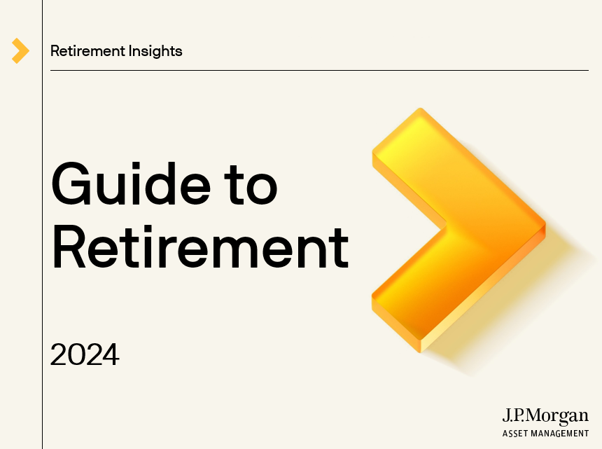

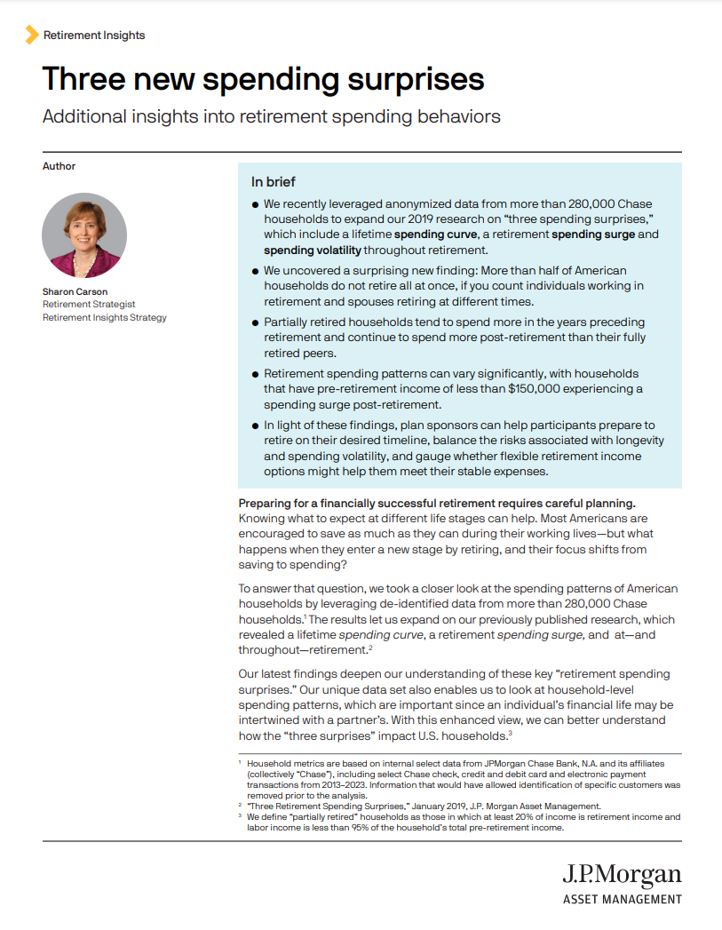
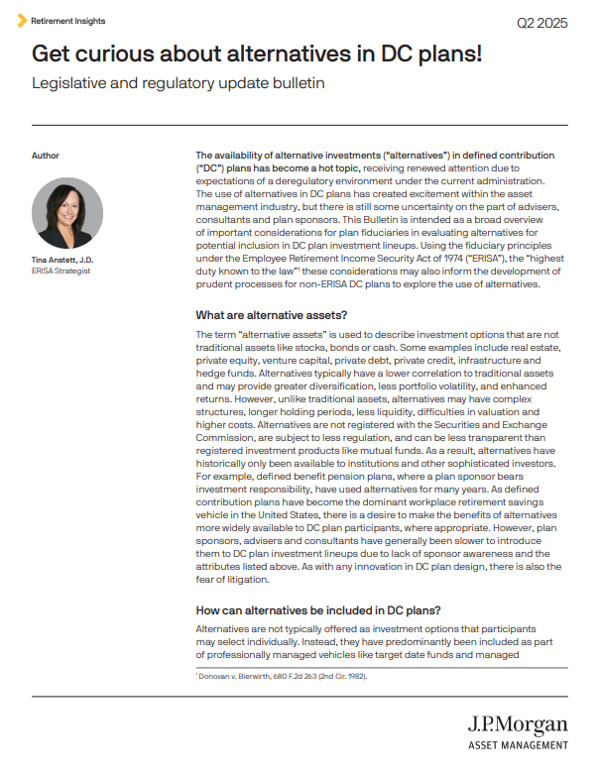

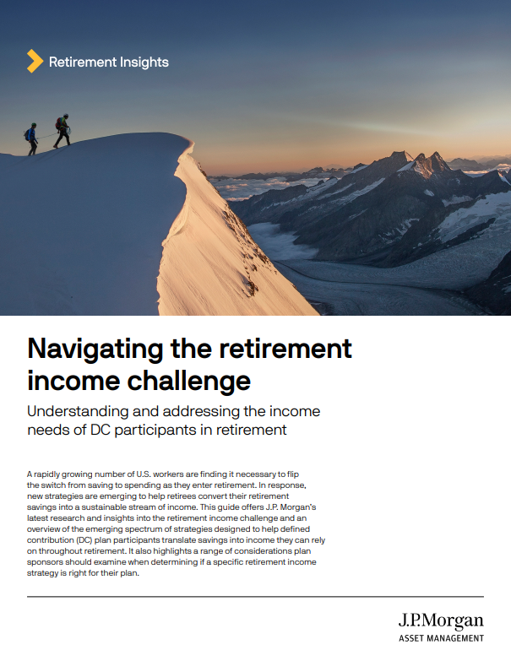
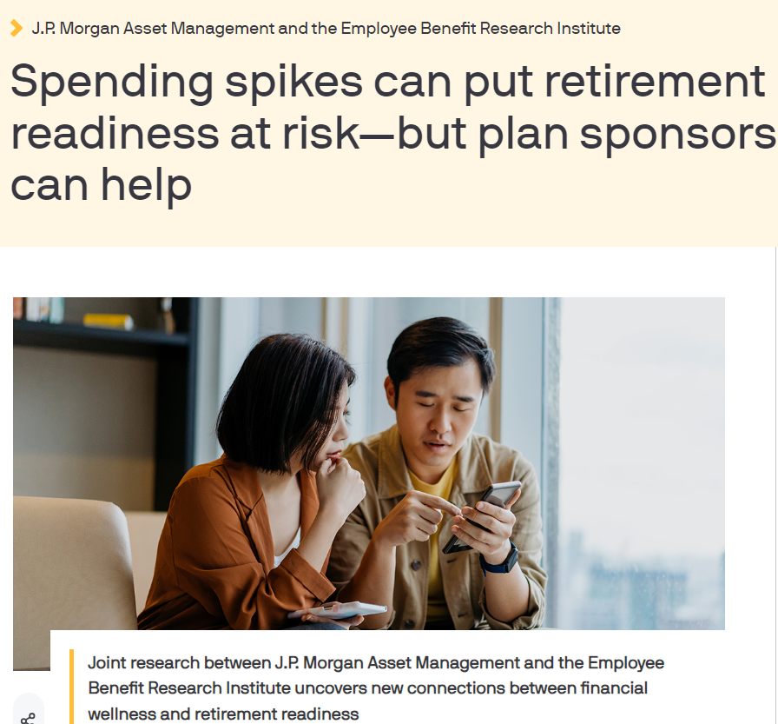


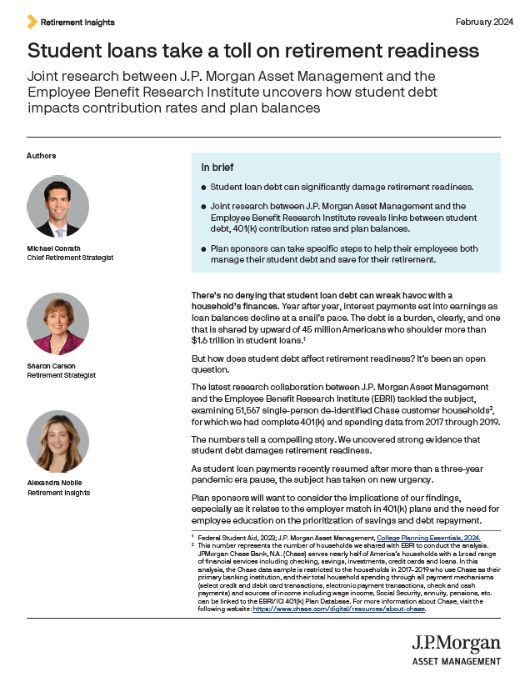

Retirement insights
  Better understand real-world participant and plan sponsor attitudes and behaviors.
Guide to Retirement
Principles for a successful retirement
Three new spending surprises
Legislative and Regulatory
The Guide to Retirement provides an effective framework for supporting your retirement planning conversations. It includes charts and graphs to help explain complex topics in a clear and concise manner
The Principles uses select, participant-friendly slides from the Guide to Retirement to help simplify retirement planning conversations
Leveraging anonymized data from more than 280,000 Chase households, we expand our research to include a lifetime spending curve, a retirement spending surge and spending volatility throughout retirement
The latest bulletins from ERISA Strategist, Tina Anstett, cover hot topics like alternative investments in DC plans and what to expect from the new administration when it comes to retirement legislation
Navigating the retirement income challenge
Joint research with the Employee Benefit Research Institute
Defined Contribution Plan Sponsor & Participant Survey Findings
Our 2024 participant survey includes insights on financial wellness, plan investments, and retirement income. 2025 plan sponsor survey results coming soon
Retirement by the Numbers*
This research shows how retirement saving and spending patterns can add up to more successful funding outcomes – coming soon
Our latest insights discuss key drivers behind the retirement income challenge and the various strategies available
The latest research from the Chase data and EBRI partnership uncovers how student debt and spending spikes impact retirement decisions and outcomes
* Coming in 2025
Notes:
Our Guide to Retirement is a comprehensive tool to help participants make more informed decisions around their retirement savings, Social Security and health care, while also navigating markets, being strategic around taxes, and preparing for longevity risks and spending shocks. The Guide can also be used to conduct educational sessions with plan sponsors and employees.
Beyond the Guide, our Retirement Insights team offers a comprehensive suite of research and thought leadership materials to help improve retirement readiness.
We continue to evolve the SmartRetirement platform:
We’ve added a seasoned portfolio manager to the fund who brings 20 years of experience to the team.
We’ve reduced fees in the Mutual Funds and Commingled Trust Funds.
We continue to innovate in the retirement income space, an area that many of our clients are exploring as more baby boomers reach retirement age. Plan sponsors and participants are interested in exploring in-plan income options, and advisors are engaging with us to discuss our innovative approach to meet that need.
Contact your JPM representative to be connected with these resources and learn more about our innovative new solutions.

Slide 8
SmartRetirement Blend Funds performance
Performance at NAV as of 3/31/25
Fund Name | 3M (%) | YTD (%) | 1Y (%) | 3Y (%) | 5Y (%) | 10Y (%) | SI (%)* | Inception Date
JPMorgan SmartRetirement Blend Income Fund R6 Shares (JIYBX) | 1.21% | 1.21% | 6.38% | 3.81% | 6.38% | 4.48% | 4.93% | 07/02/2012
S&P Target Date Retirement Income Index | 1.61% | 1.61% | 5.80% | 3.59% | 5.40% | 4.14% | 4.55%
Morningstar Percentile Ranking | - | - | 1% (2/139) | 9% (13/130) | 10% (12/114) | 19% (15/76) | 18% (17/90)
JPMorgan SmartRetirement Blend 2020 Fund R6 Shares (JSYRX) | 1.24% | 1.24% | 6.37% | 3.86% | 6.66% | 4.91% | 5.98% | 07/02/2012
S&P Target Date 2020 Index | 1.05% | 1.05% | 5.84% | 3.94% | 7.48% | 5.39% | 6.47%
Morningstar Percentile Ranking | - | - | 8% (17/133) | 17% (19/123) | 82% (88/112) | 79% (47/66) | 85% (57/72)
JPMorgan SmartRetirement Blend 2025 Fund R6 Shares (JBYSX) | 1.09% | 1.09% | 6.43% | 4.02% | 8.14% | 5.61% | 6.81% | 07/02/2012
S&P Target Date 2025 Index | 0.94% | 0.94% | 5.83% | 4.13% | 8.72% | 5.99% | 7.16%
Morningstar Percentile Ranking | - | - | 4% (14/177) | 21% (29/166) | 63% (83/145) | 60% (45/94) | 62% (58/103)
JPMorgan SmartRetirement Blend 2030 Fund R6 Shares (JRBYX) | 0.69% | 0.69% | 6.48% | 4.63% | 9.72% | 6.38% | 7.64% | 07/02/2012
S&P Target Date 2030 Index | 0.50% | 0.50% | 5.94% | 4.70% | 10.20% | 6.65% | 7.89%
Morningstar Percentile Ranking | - | - | 6% (14/198) | 19% (31/188) | 53% (78/162) | 56% (47/105) | 51% (54/113)
JPMorgan SmartRetirement Blend 2035 Fund R6 Shares (JPYRX) | 0.24% | 0.24% | 6.53% | 5.24% | 11.42% | 7.10% | 8.40% | 07/02/2012
S&P Target Date 2035 Index | 0.15% | 0.15% | 6.01% | 5.22% | 11.75% | 7.34% | 8.60%
Morningstar Percentile Ranking | - | - | 10% (18/195) | 16% (32/180) | 35% (63/156) | 47% (45/105) | 49% (52/111)
JPMorgan SmartRetirement Blend 2040 Fund R6 Shares (JOBYX) | -0.10% | -0.10% | 6.57% | 5.73% | 12.67% | 7.67% | 8.94% | 07/02/2012
S&P Target Date 2040 Index | -0.32% | -0.32% | 6.11% | 5.74% | 12.93% | 7.87% | 9.15%
Morningstar Percentile Ranking | - | - | 12% (18/193) | 22% (42/183) | 41% (70/157) | 48% (46/105) | 51% (58/113)
JPMorgan SmartRetirement Blend 2045 Fund R6 Shares (JMYAX) | -0.37% | -0.37% | 6.56% | 6.06% | 13.68% | 7.99% | 9.20% | 07/02/2012
S&P Target Date 2045 Index | -0.44% | -0.44% | 6.12% | 6.09% | 13.66% | 8.19% | 9.50%
Morningstar Percentile Ranking | - | - | 20% (27/190) | 28% (47/180) | 34% (49/156) | 47% (43/105) | 52% (56/110)
JPMorgan SmartRetirement Blend 2050 Fund R6 Shares (JNYAX) | -0.51% | -0.51% | 6.57% | 6.22% | 13.80% | 8.08% | 9.27% | 07/02/2012
S&P Target Date 2050 Index | -0.75% | -0.75% | 6.20% | 6.28% | 14.04% | 8.38% | 9.75%
Morningstar Percentile Ranking | - | - | 18% (26/191) | 26% (41/181) | 42% (59/157) | 50% (44/105) | 59% (66/111)
JPMorgan SmartRetirement Blend 2055 Fund R6 Shares (JTYBX) | -0.52% | -0.52% | 6.55% | 6.25% | 13.81% | 8.07% | 9.23% | 07/02/2012
S&P Target Date 2055+ Index | -0.76% | -0.76% | 6.19% | 6.29% | 14.16% | 8.45% | 9.87%
Morningstar Percentile Ranking | - | - | 22% (30/191) | 27% (42/181) | 53% (71/157) | 51% (45/99) | 64% (63/97)
JPMorgan SmartRetirement Blend 2060 Fund R6 Shares (JAAYX) | -0.51% | -0.51% | 6.59% | 6.28% | 13.80% | - | 9.08% | 08/31/2016
S&P Target Date 2060 Index | -0.89% | -0.89% | 6.16% | 6.31% | 14.17% | - | 9.55%
Morningstar Percentile Ranking | - | - | 18% (25/190) | 28% (42/180) | 60% (76/151) | - | 64% (72/116)
JPMorgan SmartRetirement Blend 2065 Fund R6 Shares (JSBYX) | -0.49% | -0.49% | 6.28% | - | - | - | 15.00% | 11/01/2022
S&P Target Date 2065+ Index | -0.97% | -0.97% | 6.28% | - | - | - | 15.32%
Morningstar Percentile Ranking | - | - | 27% (35/185) | - | - | - | 61% (82/164)
Source: Morningstar; as of 3/31/25. Mutual funds are subject to certain market risks. Investment returns and principal value of an investment will fluctuate so that an investor's shares, when redeemed, may be worth more or less than original cost. Current performance may be higher or lower than the performance data shown. For performance current to the most recent month-end, please call 1-800-338-4345. Source: J.P. Morgan Asset Management, Morningstar. Different share classes may have different ratings. Please see disclosure page for index definitions. Performance inception: July 02, 2012 for Income, 2020, 2025, 2030, 2035, 2040, 2045, 2050 and 2055 Funds. August 31, 2016 for the 2060 Fund. November 01, 2022 for the 2065 Fund. Benchmark data begins with first full month of performance data. Past performance is no guarantee of future results.

Slide 9
J.P. Morgan Asset Management
Investment Risks: Small- and mid-capitalization portfolios typically carry more risk than stock funds investing in well-established “blue-chip” companies because smaller companies generally have a higher risk of failure. Historically, smaller companies’ stock has experienced a greater degree of market volatility than the average stock.
The price of equity securities may rise or fall because of changes in the broad market or changes in a company’s financial condition, sometimes rapidly or unpredictably. These price movements may result from factors affecting individual companies, sectors or industries selected for a portfolio or the securities market as a whole, such as changes in economic or political conditions. When the value of a portfolio’s securities goes down, your investment will decreases in value. The manager may use derivatives in connection with its investment strategies. Derivatives may be riskier than other types of investments because they may be more sensitive to changes in economic or market conditions than other types of investments and could result in losses that significantly exceed the strategy’s original investments. Certain derivatives may give rise to a form of leverage. As a result, the strategy may be more volatile than if the strategy had not been leveraged because the leverage tends to exaggerate the effect of any increase or decrease in the value of the portfolio’s securities. Derivatives are also subject to the risk that changes in the value of a derivative may not correlate perfectly with the underlying asset, rate or index. The use of derivatives for hedging or risk management purposes or to increase income or gain may not be successful, resulting in losses to a portfolio, and the cost of such strategies may reduce a portfolio’s returns. Derivatives would also expose a portfolio to the credit risk of the derivative counterparty. Investing in bonds and other debt securities is also subject to the risk that issuers and/or counterparties will fail to make payments when due or default completely. The value of a portfolio may be adversely affected if any of the issuers or counterparties it is invested in are subject to an actual or perceived deterioration in their credit quality. Credit spreads may increase, which may reduce the market values of the portfolio’s securities. Credit spread risk is the risk that economic and market conditions or any actual or perceived credit deterioration may lead to an increase in the credit spreads (i.e., the difference in yield between two securities of similar maturity but different credit quality) and a decline in price of the issuer’s securities. Investments in foreign issuers and foreign securities (including depositary receipts) are subject to additional risks, including political and economic risks, unstable governments, civil conflicts and war, greater volatility, decreased market liquidity, expropriation and nationalization risks, sanctions or other measures by the United States or other governments, currency fluctuations, higher transaction costs, delayed settlement, possible foreign controls on investment, and less stringent investor protection and disclosure standards of foreign markets. In certain markets where securities and other instruments are not traded “delivery versus payment,” a portfolio may not receive timely payment for securities or other instruments it has delivered or receive delivery of securities paid for and may be subject to increased risk that the counterparty will fail to make payments or delivery when due or default completely. Foreign market trading hours, clearance and settlement procedures, and holiday schedules may limit the manager’s ability to buy and sell securities.
ESG Integration: In actively managed assets deemed by J.P. Morgan Asset Management (“JPMAM”) to be ESG integrated under our governance process, we systematically assess financially material ESG factors (alongside other relevant factors) in our investment decisions with the goals of managing risk and improving long-term returns. Environmental issues are defined as issues related to the quality and function of the natural environment and natural systems. Some examples include greenhouse gas emissions, climate change resilience, pollution (air, water, noise, and light), biodiversity/habitat protection and waste management. Social issues are defined as issues related to the rights, wellbeing and interests of people and communities. Some examples include workplace safety, cybersecurity and data privacy, human rights, local stakeholder relationships, and discrimination prevention. Governance issues are issues related to the way companies are managed and overseen. Some examples include independence of chair/board, fiduciary duty, board diversity, executive compensation and bribery and corruption. These examples of ESG issues are provided for illustrative purposes and are not exhaustive. In addition, as JPMAM’s approach to ESG integration focuses on financial materiality, not all factors are relevant to a particular investment, asset class, or Fund. ESG integration does not change a strategy’s investment objective, exclude specific types of companies or constrain a strategy’s investable universe. ESG integration is dependent upon the availability of sufficient ESG information relevant to the applicable investment universe. ESG factors may not be considered for each and every investment decision, In order for a [strategy][fund] to be considered ESG integrated, JPMAM requires: (1) portfolio management teams to consider proprietary research on the financial materiality of ESG issues on the [Fund’s investments]; (2) documentation of the Adviser’s internal research views and methodology throughout the investment process; and (3) appropriate monitoring of ESG considerations in ongoing risk management and portfolio monitoring. ESG determinations may not be conclusive and securities of companies/issuers may be purchased and retained, without limit, by the Adviser regardless of potential ESG impact. The impact of ESG integration on a Fund’s performance is not specifically measurable as investment decisions are discretionary regardless of ESG considerations.
Any securities/portfolio holdings mentioned throughout the presentation are shown for illustrative purposes only and should not be interpreted as recommendations to buy or sell. A full list of firm recommendations for the past year are available upon request.

Slide 10
J.P. Morgan Asset Management
Indices: The S&P Target Date Index Series reflects exposure to various asset classes included in target date funds driven by a survey of such funds for each particular target date. These asset class exposures are represented by indices of securities in the index calculation. Prior to May 31, 2017 the asset class exposures were represented by ETFs net of fees. The Index returns are calculated on a daily basis. The JPMCB SmartRetirement DRE Composite Benchmark is a customized benchmark of the following unmanaged market indexes: S&P 500 Index, S&P 400 Index, Russell 2000 Index, MSCI US REIT Index, MSCI EAFE Index (net total return), MSCI Emerging Markets Index (net total return), NFI ODCE Value Weighted Index, Bloomberg U.S. Aggregate Index, Bloomberg U.S. Treasury Inflation Notes: 1-10 Year Index, Bloomberg U.S. High Yield - 2% Issuer Cap Index, EMBI Global Diversified Index and FTSE 3-Month Treasury Bill Index. Each index is weighted to reflect the strategic asset class allocation of the JPMCB SmartRetirement DRE Fund and are adjusted over time to correspond to changes in the Fund's strategic asset class allocations. For performance commencing February 01, 2020 to August 31, 2021, the IA SBBI US 30 Day TBill TR USD Index represented the Money Market/Cash and Cash Equivalents component of the benchmark. For performance commencing February 1, 2020 to January 31, 2023, the Russell Midcap Index represented the U.S. Mid Cap Equity component of the benchmark. For periods prior to February 1, 2020, the composite benchmark was a weighted average of the benchmarks associated with the underlying funds in which the Fund invested in. Commingled funds have fees and expenses that reduce their performance: indexes do not. You cannot invest directly in an index.
Mutual funds have fees that reduce their performance: indexes do not. You cannot invest directly in an index. The S&P Target Date Index Series reflects exposure to various asset classes included in target date funds driven by a survey of such funds for each particular target date. These asset class exposures are represented by indices of securities in the index calculation. Prior to May 31, 2017 the asset class exposures were represented by ETFs net of fees. The Index returns are calculated on a daily basis. The JPM SmartRetirement Fund Composite Benchmark is a customized benchmark of the following unmanaged market indexes: S&P 500 Index, S&P 400 Index, Russell 2000 Index, MSCI US REIT Index, MSCI EAFE Index (net total return), MSCI Emerging Markets Index (net total return), Bloomberg U.S. Aggregate Index, Bloomberg U.S. Treasury Inflation Notes: 1-10 Year Index, Bloomberg U.S. High Yield - 2% Issuer Cap Index, EMBI Global Diversified Index and FTSE 3-Month Treasury Bill Index. Each index is weighted to reflect the strategic asset class allocation of the JPM SmartRetirement Fund and are adjusted over time to correspond to changes in the Fund's strategic asset class allocations. For performance commencing February 01, 2020 to August 31, 2021, the IA SBBI US 30 Day TBill TR USD Index represented the Money Market/Cash and Cash Equivalents component of the benchmark. For performance commencing February 1, 2020 to January 31, 2023, the Russell Midcap Index represented the U.S. Mid Cap Equity component of the benchmark. For periods prior to February 1, 2020, the composite benchmark was a weighted average of the benchmarks associated with the underlying funds in which the Fund invested in.
Risk Summary: This investment is not a complete retirement program and may not provide sufficient retirement income. The manager seeks to achieve the stated objectives. There can be no guarantee the objectives will be met. Investing in these strategies carries a certain amount of risk. There can be no guarantee that investing in these strategies will prevent loss of an investment. To achieve its strategy, the Fund may invest in other underlying collective trust funds and exchange-traded funds, so the Fund’s investment performance is directly related to the performance of the underlying funds. The investment objective of an underlying funds may differ from, and an underlying funds may have different risks than, the Fund. There is no assurance that the underlying funds will achieve their investment objectives. International investing involves increased risk and volatility due to possibilities of currency exchange rate volatility, political, social or economic instability, foreign taxation and differences in auditing and other financial standards. Investments in smaller companies may be riskier, less liquid, more volatile and more vulnerable to economic, market and industry changes than investment in larger, more established companies. Changes in the price of debt or equity issued by such companies may be more sudden or erratic than the prices of other securities, especially over the short term. Securities rated below investment grade are considered "high-yield," "non-investment grade," "below investment-grade," or "junk bonds." They generally are rated in the fifth or lower rating categories of Standard & Poor's and Moody's Investors Service. Although they can provide higher yields than higher rated securities, they can carry greater risk. The underlying funds may use derivatives, which are instruments that have a value based on another instrument, exchange rate or index. In addition, the Fund may invest directly in derivatives. Derivatives may be riskier than other types of investments because they may be more sensitive to changes in economic and market conditions and could result in losses that significantly exceed the Fund’s or the underlying Funds’ original investments. Many derivatives will give rise to a form of leverage. As a result, the Fund or an underlying fund may be more volatile than if the Fund or the underlying Fund had not been leveraged because the leverage tends to exaggerate the effect of any increase or decrease in the value of the Fund’s or the underlying Fund’s portfolio securities. Derivatives are also subject to the risk that changes in the value of a derivative may not correlate perfectly with the underlying asset, rate or index. The use of derivatives for hedging or risk management purposes or to increase income or gain may not be successful, resulting in losses, and the cost of such strategies may reduce the Fund’s or the underlying funds’ returns. Derivatives also expose the Fund or the underlying funds to the credit risk of the derivative counterparty. There may be additional fees or expenses associated with investing in a Fund of Funds strategy. Asset allocation/diversification does not guarantee investment returns and does not eliminate the risk of loss.

Slide 11
J.P. Morgan Asset Management
Sample Withdrawal Amount Risk: The Spending Phase of the Fund is designed for investors in retirement who intend to spend down their holdings in the Fund. There is no guarantee that the Fund will provide sufficient retirement income, the sample withdrawal amount for any given year may be zero in order to preserve capital and you may lose money invested in the Fund. You should not rely solely on the sample withdrawal amount in determining your retirement income needs.
Maturity Date Risk: While assets invested in the Fund are expected to decline over time and equal zero on the maturity date, the Fund may be liquidated prior to the maturity date. For example, as assets decline and approach zero, there may be a point before the maturity date where the Adviser can no longer manage the Fund in-line with its investment goal and the Fund may be liquidated at the discretion of the Board of Trustees. In addition, as assets in the Fund decline, the expenses of the Fund may increase. There can be no assurance that the professionals currently employed by JPMAM will continue to be employed by JPMAM or that the past performance or success of any such professional serves as an indicator of such professional’s future performance or success. Any securities/portfolio holdings mentioned throughout the presentation are shown for illustrative purposes only and should not be interpreted as recommendations to buy or sell. The hypothetical calculations are shown for illustrated purposes only and are not meant to be representative of actual results achieved by the manager while investing in the respective strategies over the time periods shown. Hypothetical results reflect the reinvestment of all dividends. Hypothetical portfolios are constructed using representative accounts whose strategic allocations range between 30 and 50 percent in equity and remaining balance in fixed income. The actively adjusted portfolio allocations range between 15 and 65 percent in equity and remaining balance in fixed income. The hypothetical example is designed to illustrate, as an example, how active asset allocation process with volatility management framework can stabilize hypothetical withdrawal amount year over year and reduce downside risk while seeking to achieve attractive risk-adjusted return. The back-test period is from 2000-2015 using 2001-2016. Data is from 2000 through December 2015 based on index returns. Sources: Barclay’s Capital Aggregate Index, NAREIT Equity Index, MS REIT Index, S&P 500 Total Return, Russell 2000, Barclays Capital US TIPS Index, Dow Jones UBS Commodities Index, United States T-Bills, MSCI Emerging Markets Free Index, JPMorgan EMBI Global Index. Unlike an actual performance record, they do not reflect trading, liquidity constraints, fees and other costs. Also, since the trades have not actually been executed, the results may have under-or-over compensated for the impact of certain market factors such as lack of liquidity. Simulated trading programs in general are also subject to the fact that they are designed with the benefit of hindsight. These back-tested results do not take into consideration the ongoing implementation of the manager’s proprietary investment strategies. No representation is being made that any portfolio will or is likely to achieve profits or losses similar to those shown. Past performance is not indicative of future results. Returns will fluctuate and an investment upon redemption may be worth more or less than its original value. The beginning hypothetical portfolio value is assumed to be $100,000. The 10,000 simulations are run over 35 year horizon using J.P. Morgan Asset Management’s (JPMAM) proprietary Long-Term Capital Markets Assumptions (10–15 years). The main result of the model is to illustrate the set of optimized asset allocations and sample withdrawal amounts, given the simulated range of hypothetical remaining portfolio values. These values are presented in simulated portfolio value and hypothetical withdrawal rate charts – the chart marks the range of the 5th, 25th, 50th, 75th and 95th percentile distribution of outcomes.
Investors should carefully consider the investment objectives and risks as well as charges and expenses of a mutual fund or ETF before investing. The summary and full prospectuses contain this and other information about the mutual fund or ETF and should be read carefully before investing. To obtain a prospectus for Mutual Funds: Contact JPMorgan Distribution Services, Inc. at 1-800-480-4111. Exchange Traded Funds: Call 1-844-4JPM-ETF.
The “mutual funds with a 4/5 star rating” analysis is sourced from Morningstar for all funds with the exception of Japan-domiciled funds; Nomura was used for Japan-domiciled funds. The analysis includes Global Investment Management open-ended funds that are rated by the aforementioned sources. The multi-asset classification used in the illustration is based on J.P. Morgan’s own categorization. The share class with the highest Morningstar star rating represents its respective fund. The Nomura star rating represents the aggregate fund. Other share classes may have different performance characteristics and may have different ratings; the highest rated share class may not be available to all investors. All star ratings sourced from Morningstar reflect the Morningstar Overall RatingTM. For Japan-domiciled funds, the star rating is based on the Nomura 3-year star rating. Funds with fewer than three years of history are not rated by Morningstar nor Nomura and hence excluded from this analysis. Other funds which do not have a rating are also excluded from this analysis. Ratings are based on past performance and are not indicative of future results.

Slide 12
J.P. Morgan Asset Management
The Morningstar RatingTM for funds, or "star rating", is calculated for managed products (including mutual funds, variable annuity and variable life subaccounts, exchange-traded funds, closed-end funds, and separate accounts) with at least a three-year history. Exchange traded funds and open-ended mutual funds are considered a single population for comparative purposes. It is calculated based on a Morningstar Risk-Adjusted Return measure that accounts for variation in a managed product's monthly excess performance, placing more emphasis on downward variations and rewarding consistent performance. The top 10% of products in each product category receive 5 stars, the next 22.5% receive 4 stars, the next 35% receive 3 stars, the next 22.5% receive 2 stars, and the bottom 10% receive 1 star. The Overall Morningstar Rating for a managed product is derived from a weighted average of the performance figures associated with its three-, five-, and 10-year (if applicable) Morningstar Rating metrics. The weights are: 100% three-year rating for 36-59 months of total returns, 60% five-year rating/40% three-year rating for 60-119 months of total returns, and 50% 10- year rating/30% five-year rating/20% three-year rating for 120 or more months of total returns. While the 10-year overall star rating formula seems to give the most weight to the 10-year period, the most recent three-year period actually has the greatest impact because it is included in all three rating periods. Rankings do not take sales loads into account.
Target Date Funds: The JPMorgan SmartRetirement Funds are target date funds with the target date being the approximate date when investors plan to retire. Generally, the asset allocation of each Fund will change on an annual basis with the asset allocation becoming more conservative as the Fund nears the target retirement date. The principal value of the Fund(s) is not guaranteed at any time, including at the target date. This is a general communication being provided for informational purposes only. It is educational in nature and not designed to be a recommendation for any specific investment product, strategy, plan feature or other purpose. Any examples used are generic, hypothetical and for illustration purposes only. Prior to making any investment or financial decisions, an investor should seek individualized advice from personal financial, legal, tax and other professionals that take into account all of the particular facts and circumstances of an investor’s own situation. JPMorgan Mutual Funds and ETFs are distributed by JPMorgan Distribution Services, Inc. (JPMDS) and offered by J.P. Morgan Institutional Investments, Inc. (JPMII); both affiliates of JPMorgan Chase & Co. Affiliates of JPMorgan Chase & Co. receive fees for providing various services to the funds. JPMDS and JPMII are both members of FINRA. If you are a person with a disability and need additional support in viewing the material, please call us at 1-800-343-1113 for assistance. Telephone calls and electronic communications may be monitored and/or recorded.
Personal data will be collected, stored and processed by J.P. Morgan Asset Management in accordance with our privacy policies at https://www.jpmorgan.com/privacy.
J.P. Morgan Asset Management is the marketing name for the asset management businesses of JPMorgan Chase & Co. and its affiliates worldwide. Those businesses include, but are not limited to, JPMorgan Chase Bank, N.A., J.P. Morgan Investment Management Inc., Security Capital Research & Management Incorporated, and J.P. Morgan Alternative Asset Management, Inc.
Copyright 2025 JPMorgan Chase & Co. Conflicts of Interest: Refer to the Conflicts of Interest section of the Fund's Prospectus.
Material ID: 095t240305192231

